Slide 1
Capstone- Battle of Neighborhoods (week2)

Slide 2

City of Toronto
Source: https://www.toronto.ca/

Slide 3
Introduction
City of Toronto is multicultural and multiracial city
With the population of almost 3 million
There are various ethnic restaurants and ethnic foods
Source: https://en.wikipedia.org/wiki/Toronto

Slide 4
The Problem
Fiding an ideal location for opening a new restaurant in big cities have always been an issue
We would like to open a Mediterranean restuarant
How can we use data science to spot the best location for our new business in Toronto?

Slide 5
Data
We use „List of postal codes of Canada“ in Wikipedia to get a list of boroughs and neighborhoods in Toronto
We use Foursqueare API to get the correspoding venues data for the city of Toronto
Rating data, price category, location for each venue
Source: https://en.wikipedia.org/wiki/List_of_postal_codes_of_Canada:_M

Slide 6
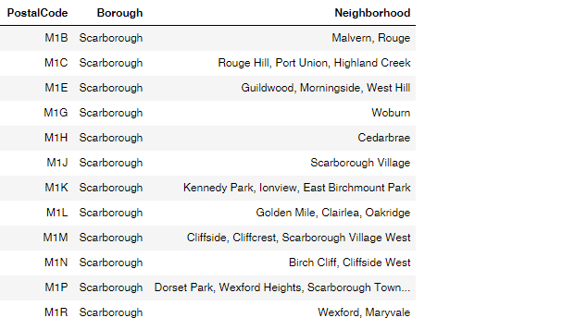
Borough-Neighborhood Data

Slide 7
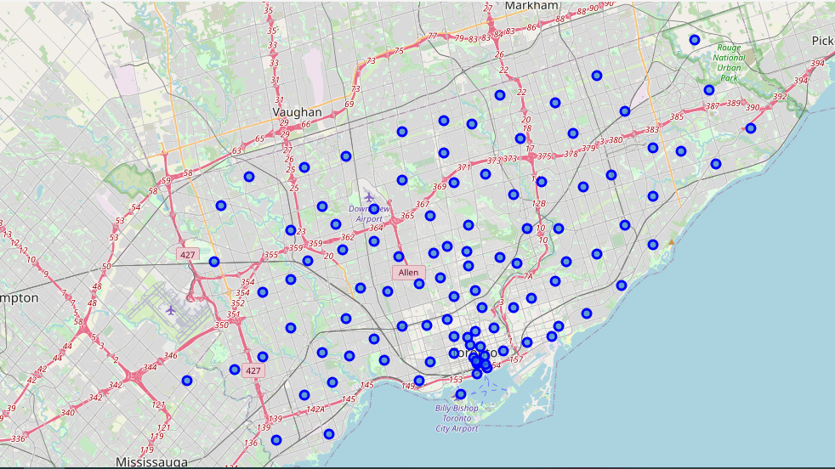
Folium map of Toronot‘s neighborhood

Slide 8
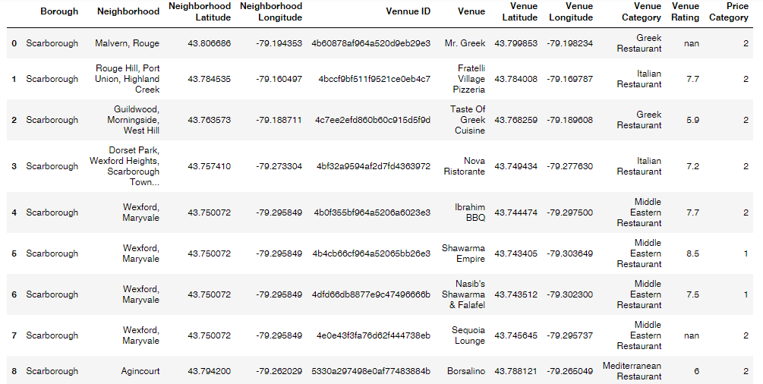
Venue Data

Slide 9
Our interests
Popularity of Mediterranean restaurant among residents of Toronto
Number of neighborhoods in each borough
Neighborhoods with most of Mediterranean cuisine.
Neighborhoods with less restaurants
Average rating of Mediterranean restaurant in various neighborhoods of Toronto

Slide 10
Results

Slide 11
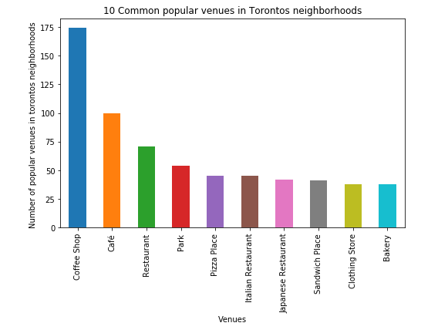
10 most prevalent venues

Slide 12
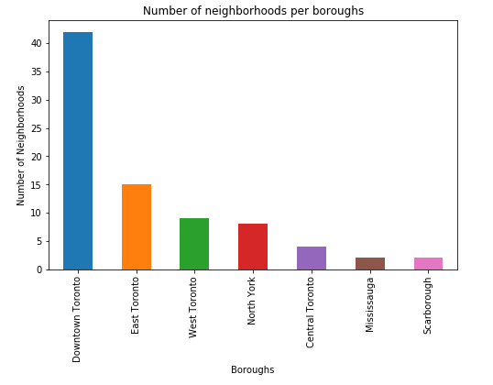
Distribution of Neibohoods

Slide 13
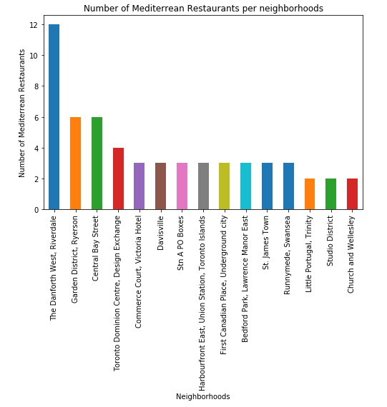
Mediterranean restaurants in various neighborhoods

Slide 14
Average rating of Mediterranean restaurants in 6 boroughs

Slide 15
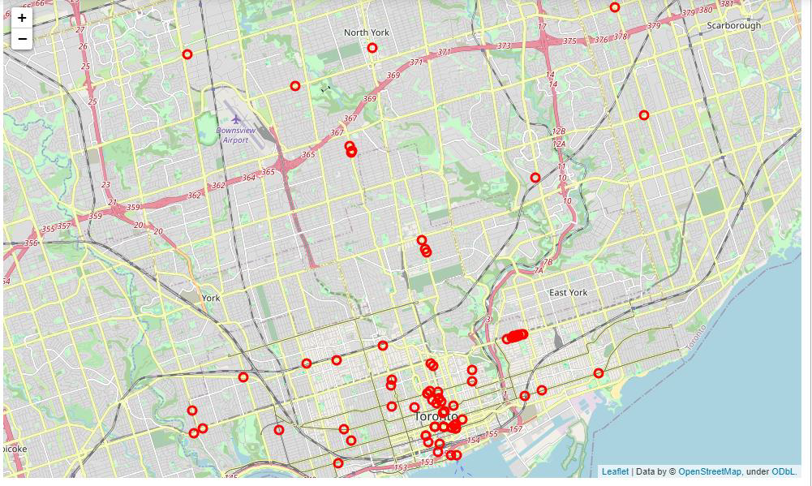
Folium map of Toronto‘s restaurant

Slide 16
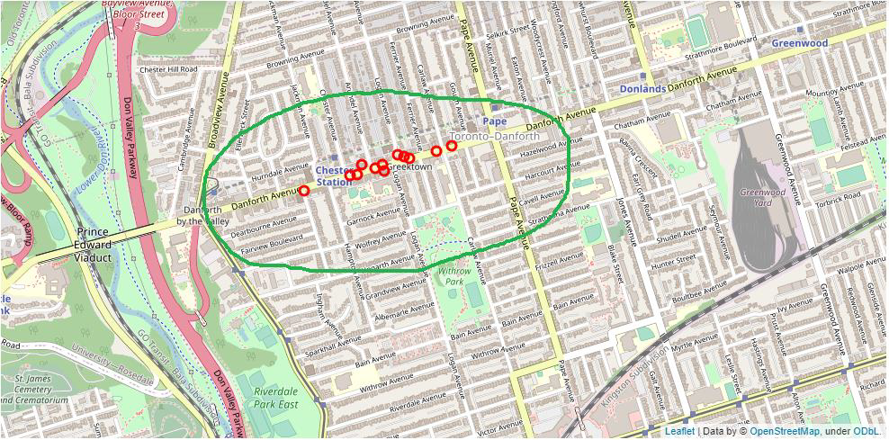
First Sugessted neighborhood
The Danforth West in East Toronto

Slide 17
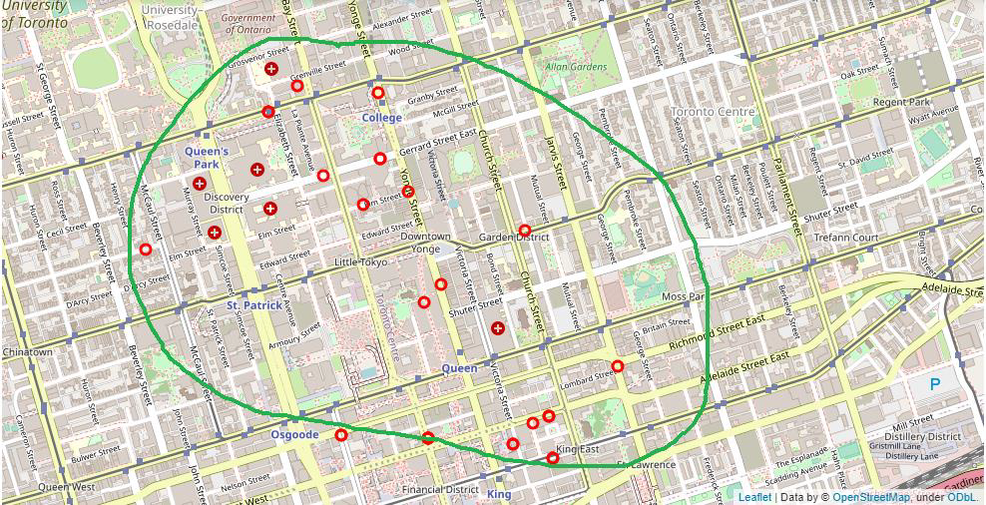
Second sugessted neighborhood
Garden District in Downtown Toronto

